Slide 1
GetMyFlight
Cheapest Flight Rates in No Time
Group No - 3
Aastha Grover
Ankur Bag
Neelesh Saxena
Tushar K

Slide 2
Problem Statement
Unpredictability and uncertainty of flight fares.
‘The earlier you book, the cheaper you get’ - is always not true.
Flight Reservation websites are in a rush to provide their customers with the cheapest flights.
Nobody is bothered how the rates will vary in the future. This is where our research is centered.
Our Proposal/Suggestion:
Build a flight recommendation system -
To predict the flight rates to a particular destination for the given dates.

Slide 3
Synopsis
Actor/Use Case
Architecture & Infrastructure
Data Preprocessing Phase
Algorithm Selection Phase
Algorithm Selection Phase

Slide 4
Actor/Use Cases
Actor
User is the sole actor of the system.
Use Case
User will input Preferred dates and Source-Destination.
System will predict when to book the tickets.

Slide 5
Architecture
AWS /Heroku
Front End (Play/Activator/Api.Ai Bot)
(View)
BackEnd : (Spark-Engine
/MySQL)
(Model)
Spark and DeepLearning4J
(Controller)

Slide 6
Infrastructure
User Interface: PlayFramework , Scala Controllers, Javascript, Bootstrap,CSS, HTML and api io.
DataBase : In memory database (PostgresSQL), MySql deployed on Amazon Web Services, Slick for Database Querying.
Apache Spark - Scala Integration : Neural Network Algorithm implemented in Scala using deeplearning4j.
Data Cleansing & Preparation : R Script

Slide 7
Data Preprocessing Phase

Slide 8
About Data
Data is for two years (2015 and 2016) and it was originally divided into quarters with each quarter having approximately 50000 records and 26 columns.
Data has several features like : CARRIER, ORIGIN, DESTINATION, SEATS (available), DATE_OF_BOOKING, DATE_OF_TRAVEL, BASE_FARE, TICKET_FARE and (LATITUDE,LONGITUDE) for Origin and Destination.
We gathered the data from different tables which was available on (Official Beureau Of Transportation)
Source : http://www.transtats.bts.gov/

Slide 9
Feature Vector
Source, Destination
Latitude & longitude for source and destination.
Number of seats available for each carrier, as a measure of demand.
Date of booking for flight.
Base Fare : It is a fixed value set by International Air Transport Association(IATA).
Date Of Travel
Ticket Fare: Market fare for each itinerary.

Slide 10
Feature Selection
We used linear regression and P-values statistic to identify the correlation of each input feature with the predicted variable (Ticket Fare).
We also used wrapper methods to try different combinations of attributes.
Tested the attribute combinations with forward and backward passes to add or remove features which gave us the best combination of input attributes.
The final attributes used for building a prediction model are:
Carrier
Base Fare
Origin-Destination
Date of Travel
Seats Available

Slide 11
Algorithm Selection Phase

Slide 12
Possible Machine learning Algorithms
Multiple Linear Regression
Decision Trees
Neural Networks

Slide 13
Data Preparation For Neural Network ( R Script )
Neural Networks gives optimized performance only on the normalized data inputs. Range between -1 to 1 is desired although higher numeric ranges also work depending on the feature set.
Therefore we normalized the categorical & continuous variables using different techniques suitable for each column.
Categorical Variables : Assigned their occurrence frequency and used Decimal - Binary Conversion.
Continuous Variables : Z-Score normalization.

Slide 14
Implementing Neural Network
Set the Parameters ( Seed, Train Sample, learning Rate, Number of hidden Layers, Number of nodes in each hidden layer).
Feature Selection to predict the Ticket fare.
Training : Build the network of neurons Using Multilayer Network class of deeplearning4j.
Tuning Parameters: Adjusted hidden layers, number of nodes per hidden layer and learning rate to improve the prediction.
Testing : Predicting the Ticket fare ( Target Variable) for 2016 dataset.
Conclusion:
Lower the learning rate , higher the prediction accuracy.
Adjusted the parameters to avoid overfitting.

Slide 15
Evaluation

Slide 16
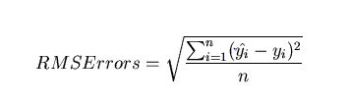
Measuring Prediction Accuracy
RMSE
Root-mean-square error (RMSE) is used to measure the differences between values predicted by a model o and the values actually observed.

Slide 17
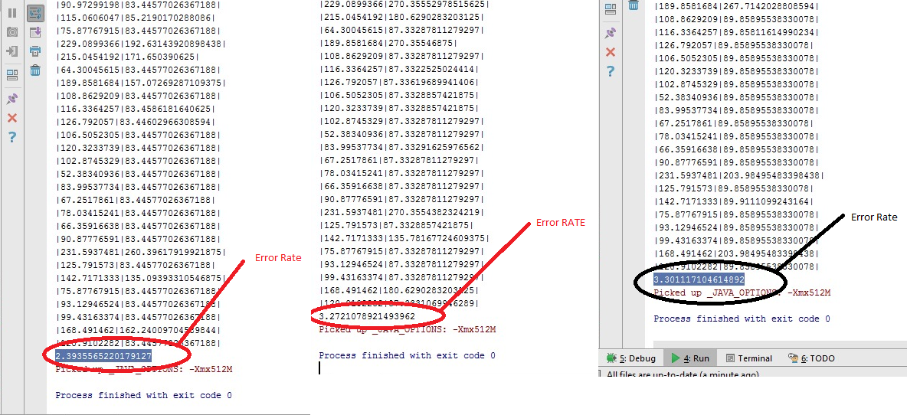
Error Rate Across Three Runs

Slide 18
Application and User Interface

Slide 19
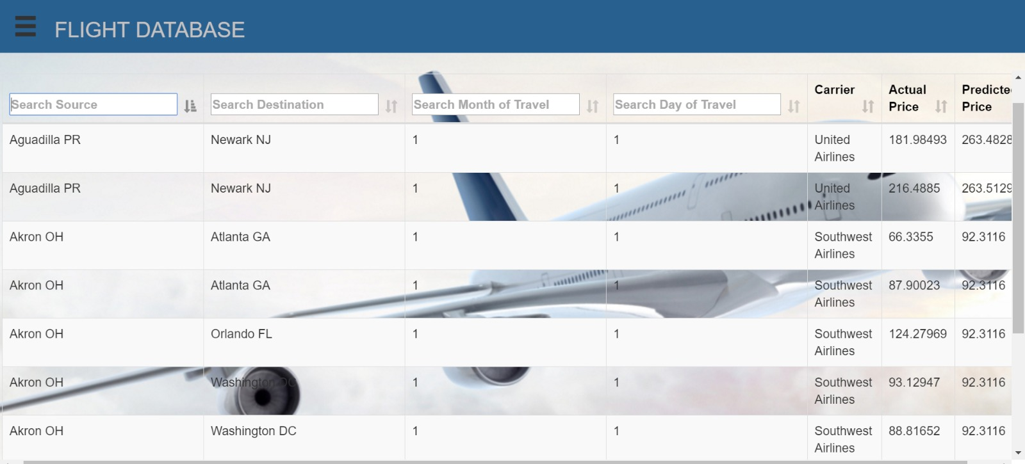

Slide 20
Using Play Framework
Object Modeling
Database Selection
Created Test specs for Application, Scala Controllers and repository.
Json, Javascript, DataTables

Slide 21
Using api.ai
Conversational User Interface
Bot Application to ask System the prediction
http://getmyflight.mx7a8jdfvi.us-west-2.elasticbeanstalk.com/

Slide 22
Acceptance Criteria
Proposed Criteria | Actual Criteria
Number Of Carrier (4) | Number Of Carrier (13)
Number Of Cities to be Analysed(6) | Number Of Cities to be Analysed(more than 20)
3 successful predictions out of 5. | Accuracy of Prediction Model :70%

Slide 23
Challenges Faced & Solutions
Data Collection issues : Merged the data from different tables
Unpredictable results with initial feature vector.
Technology to use since the data was too big : 365 days
Best Suitable Algorithm for the given problem at hand.
Restructuring the data to use it for input format.
Customizing the algorithm
Normalizing the data (Categorical a well as Continuous)for input to neural network.
Application configuration issues with Play Framework, Data Modelling

Slide 24
Scope
Integrating Play Framework application with our Spark algorithm so that we can make near real time predictions.
Predicting for International as well as Domestic Flights.
Taking Roundtrips into consideration.

Slide 25
Milestones
Key Milestones | Start Date | End Date
Feature Selection Dataset Creation. Decide the architecture of the application. | 11/3/2016 | 11/10/2016
Data Analysis - Data Visualization, Data Cleansing / Manipulation Decision on the machine learning algorithm. | 11/10/2016 | 11/17/2016
Build the Predictive algorithm/Model. | 11/17/2016 | 11/24/2016
Application Integration , Backend Complete | 11/24/2016 | 12/5/2016
Application Test Run Executed, FrontEnd Completed | 12/1/2016 | 12/9/2016

Slide 26
Code Repository
https://github.com/ankurbag/CSYE7200_Scala_Project_Group3

Slide 27
Thank You :)

